Slide 1
Infrastructure as Code (IaC)
Moim Hossain
Application Development Manager
Microsoft

Slide 2
Session learning objectives
At the end of this session, you should be able to comprehend:
Infrastructure as Code (IaC)
Create CI/CD pipelines for your Infrastructure as Code (IaC) content.
Agenda
Infrastructure as Code
Fundamentals
Principles of Infrastructure as Code
Azure Resource Manager templates
Vision & current state of ARM templates
Anatomy of ARM templates
Azure Biceps
Vision
Modularization
Template Specs
Recommendation & best practices for ARM/Biceps
Deployment pipelines (CI/CD)

Slide 3
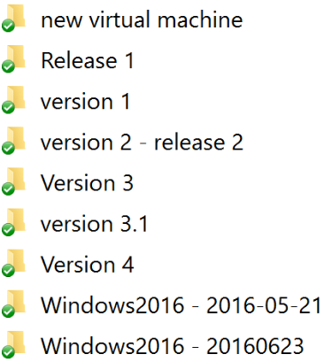

Manual Infrastructure Deployment
People Dependencies, short staffed = DELAY
Inconsistent deployment practices
Knowledge gap
Heavy customizations

Slide 4

What is Infrastructure as Code (IaC)
Infrastructure as Code is the process of managing and provisioning computing infrastructure and its configuration through machine-processable definition files. It treats the infrastructure as a software system, applying software engineering practices to manage changes to the system in a repeatable, structured and safe way.

Slide 5

Why do IaC
Declarative
Single source of truth
Repeatable and testable
Faster to provision
Idempotent provisioning and configuration (calls can be executed repeatedly while producing the same result)

Slide 6
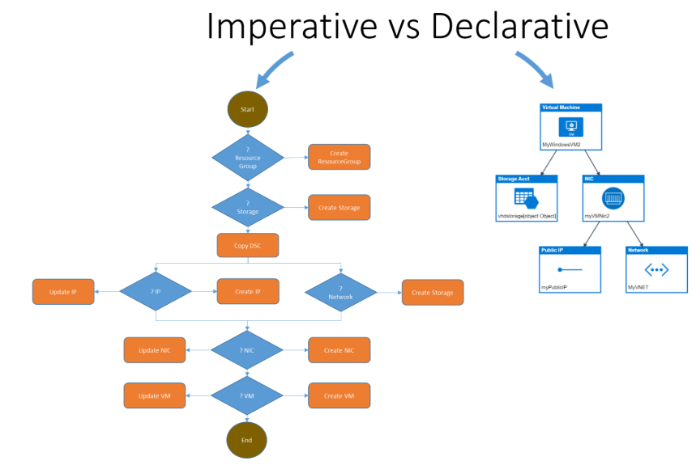
PowerShell
Azure ARM Templates
Terraform (3rd Party)

Slide 7

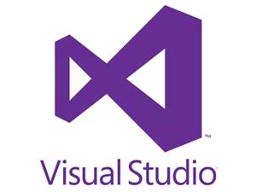
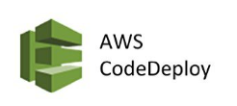



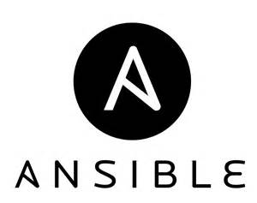







IaC in the DevOps Process Spectrum
Tools and Technologies
Core/Native
Operational Config
Cont. Integration / Deploy
Azure Resource
Manager
AWS
CloudFormation
Google Deployment
Manager
Desired State
Configuration
(DSC)
Platform
IT Ops
App/Dev

Slide 8

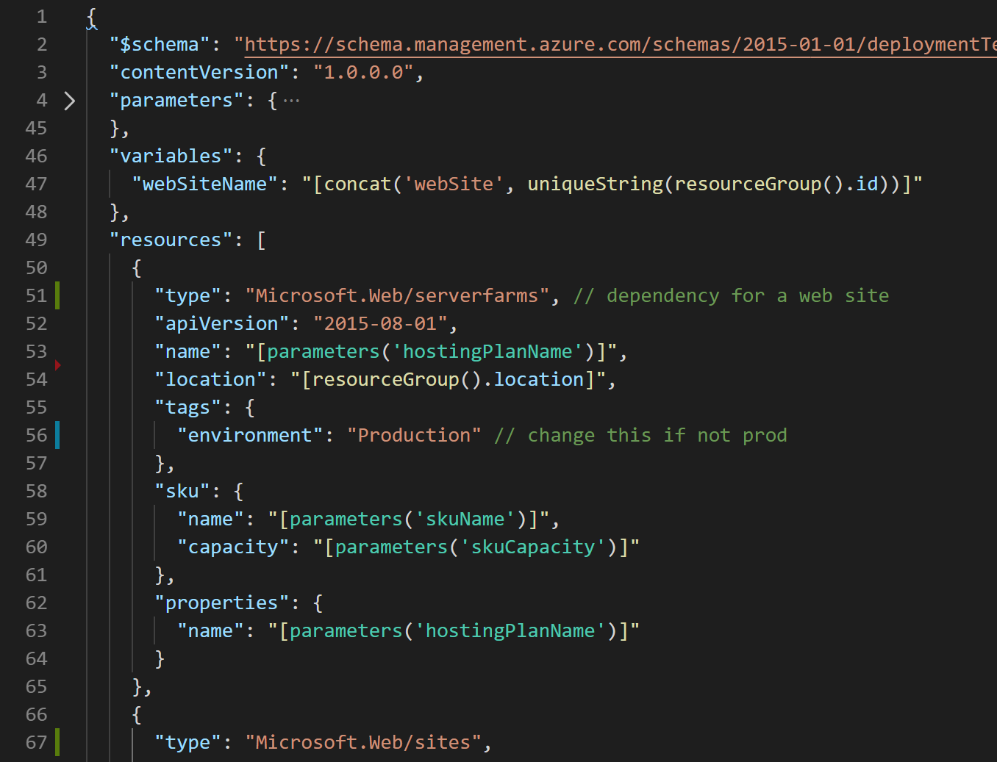




What are ARM Templates?
Declarative files for creating Azure resources in a reliable, repeatable and auditable way.
Infrastructure as Code
Define Azure resources using text files.
Declarative Syntax
Declare how the resources should be and Azure Resource Manager “makes it so”.
JSON
ARM Templates are JSON format text files. Edit them in Visual Studio Code (or other text editors). Version control them.
Meta-Language
Contains some programming language constructs such as functions and loops.
➔
https://docs.microsoft.com/en-us/azure/templates/
Notes:
Need a slide here on other “Deployment” types like terraform and how they compare. Ie. logic to perform ARM puts it handled on client slide vs server side. No validate/preflight.

Slide 9
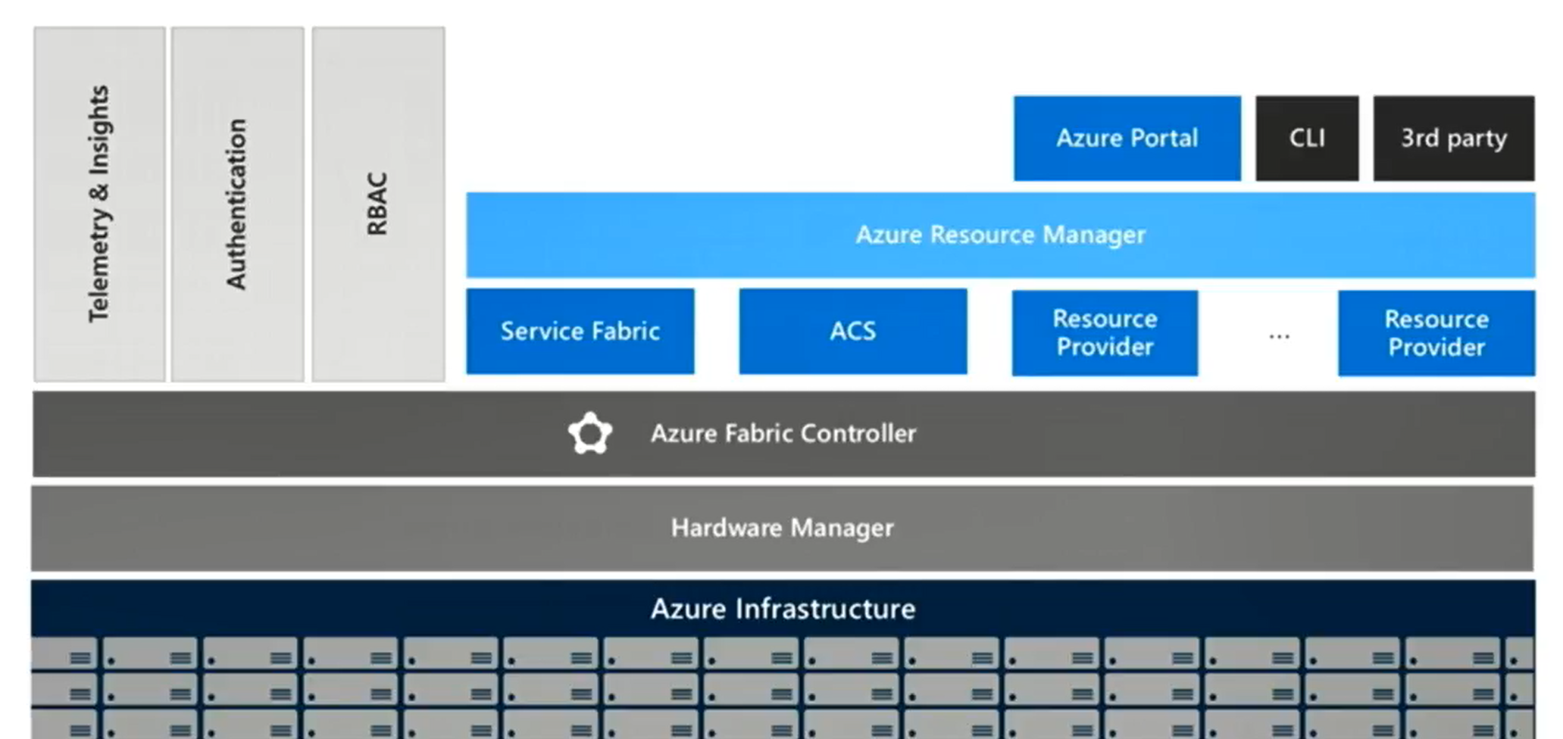
Consistent Management Layer (ARM)

Slide 10
Azure Resource Manager Benefits
Deploy, manage, and monitor all of the resources for your solution as a group
Redeploy your solution throughout the development lifecycle
Manage your infrastructure through decelerative templates rather than scripts
You can define the dependencies between resources so they are deployed in the correct order
Apply access control to all services in your resource group

Slide 11
Azure Resource Manager Terminology
resource - A manageable item that is available through Azure. Some common resources are a virtual machine, storage account, web app, database, and virtual network, but there are many more.
resource group - A container that holds related resources for an Azure solution. The resource group can include all the resources for the solution, or only those resources that you want to manage as a group. You decide how you want to allocate resources to resource groups based on what makes the most sense for your organization.
resource provider - A service that supplies the resources you can deploy and manage through Resource Manager. Each resource provider offers operations for working with the resources that are deployed. Some common resource providers are Microsoft.Compute, which supplies the virtual machine resource, Microsoft.Storage, which supplies the storage account resource, and Microsoft.Web, which supplies resources related to web apps. See Resource providers.

Slide 12
An ARM Template
An ARM template in it’s simplest structure:
{
"$schema": "http://schema.management.azure.com/schemas/2015-01-01/deploymentTemplate.json#",
"contentVersion": "",
"parameters": { },
"variables": { },
"resources": [ ],
"outputs": { }
}
Notes:
An ARM Template. Here’s the structure of an ARM template in it’s simplest form. Note the 6 elements that it consists of.

Slide 13
Template Format
{
"$schema": "http://schema.management.azure.com/schemas/2015-01-01/deploymentTemplate.json#",
"contentVersion": "",
"parameters": { },
"variables": { },
"resources": [ ],
"outputs": { }
}
Location of the JSON schema file
Your version number
Template Input parameters
Variables to simplify expressions
Resources to deploy or update
Output returned after deployment

Slide 14
ARM Template Elements
$schema is the location of the JSON schema file that describes the version of the template language.
contentVersion is an arbitrary number that is used to describe the version of the template.
Parameters are values that are provided when deployment is executed in order to customize resource deployment e.g. “MyStorageAccount”.
Variables are values that are provided once but are referenced one or more times within an ARM template in order to simplify template language expressions e.g. "storageAccountName": "StorageAccount1“.
Resources are used to define the resource types that are deployed or updated in a resource group e.g. a storage account i.e. Microsoft.Storage/storageAccounts.
Outputs are values that are returned after deployment.
Notes:
ARM Template Elements. The elements of an ARM template are defined as follows:
$schema is the location of the JSON schema file that describes the version of the template language. This ensures template language consistency.
contentVersion is an arbitrary number that is used to describe the version of the template. This is useful for your own versioning purposes.
Parameters are values that are provided when deployment is executed in order to customize resource deployment e.g. “MyStorageAccount”.
Variables are values that are provided once but are referenced one or more times within an ARM template in order to simplify template language expressions e.g. "storageAccountName": "StorageAccount1“. This prevents having to write the same value multiple times.
Resources are used to define the resource types that are deployed or updated in a resource group e.g. a storage account. This would be written as Microsoft.Storage/storageAccounts and lastly, outputs.
Outputs are values that are returned after deployment, for example, you could return the URI to access a deployed resource.

Slide 15
Deployment mode: Incremental vs Complete

Slide 16
Incremental Deployments
By default, Resource Manager handles deployments as incremental updates to a resource group.
Leaves unchanged resources that exist in the resource group but are not specified in the template.
Adds resources that are specified in the template but do not exist in the resource group.
Does not re-provision resources that exist in the resource group in the same condition defined in the template.
Re-provisions existing resources that have updated settings in the template.
Notes:
Incremental Deployments. By default, Resource Manager handles deployments as incremental updates to a resource group. With incremental deployment, Resource Manager leaves unchanged resources that exist in the resource group but are not specified in the template.
It adds resources that are specified in the template but do not exist in the resource group.
It does not re-provision resources that exist in the resource group in the same condition defined in the template and it
re-provisions existing resources that have updated settings in the template.

Slide 17
Complete Deployments
Deletes resources that exist in the resource group but are not specified in the template.
Adds resources that are specified in the template but do not exist in the resource group.
Does not re-provision resources that exist in the resource group in the same condition defined in the template.
Re-provisions existing resources that have updated settings in the template.
Type of deployment specified using the Mode property.
Notes:
Complete Deployments. With complete deployment, Resource Manager deletes resources that exist in the resource group but are not specified in the template. It adds resources that are specified in the template but do not exist in the resource group. It does not re-provision resources that exist in the resource group in the same condition defined in the template and it re-provisions existing resources that have updated settings in the template. The type of deployment is specified using the PowerShell Mode property.

Slide 18
Deployment Scopes
Resource Group (az deployment group create …)
Subscription (az deployment sub create …)
Blueprints, blueprintAssignments, policyDefinitions, budgets etc.
Management Group (az deployment mg create …)
roleEligibilityScheduleRequests, roleManagementPolicyAssignments, privateLinkAssociations etc.
Tenant (az deployment tenant create …)
billingProfiles, invoiceSections, tenantConfigurations etc.

Slide 19
DEMO

Slide 20
Template Specs
A template spec is a resource type for storing an Azure Resource Manager template (ARM template) in Azure for later deployment. This resource type enables you to share ARM templates with other users in your organization.
Template specs provide the following benefits:
You use standard ARM templates for your template spec.
You manage access through Azure RBAC, rather than SAS tokens.
Users can deploy the template spec without having write access to the template.
You can integrate the template spec into existing deployment process, such as PowerShell script or DevOps pipeline.
* The size of a template spec is limited to approximated 2 MB

Slide 21
Deployment scripts
For data plane operations, for example:
Add users to a directory
Perform data plane operations, for example, copy blobs or seed database
Look up and validate a license key
Create a self-signed certificate
Create an object in Azure AD
Look up IP Address blocks from custom system
Use deployment scripts in Bicep - Azure Resource Manager | Microsoft Docs

Slide 22
Test toolkit
Use ARM template test toolkit:
The Azure Resource Manager template (ARM template) test toolkit checks whether your template uses recommended practices. When your template isn't compliant with recommended practices, it returns a list of warnings with the suggested changes. By using the test toolkit, you can learn how to avoid common problems in template development.
The toolkit is a set of PowerShell scripts that can be run from a command in PowerShell or CLI. These tests are recommendations but not requirements. You can decide which tests are relevant to your goals and customize which tests are run.

Slide 23
What is Bicep?

Slide 24
Playground
https://aka.ms/bicepdemo

Slide 25
Goals
Reduce current pain
Ease of adoption
Compatible with existing templates
Transparent Abstraction: Leverage all the benefits of the platform
Modular: Abstract common blocks of config into reusable elements
Enjoyable experience building templates
Non-Goals
One language to rule them all
General purpose language to meet any need
Invent new technology
Re-invent the wheel (or replace)

Slide 26
Project ‘Bicep’
Simple declarative language to provision infrastructure on Azure
Bicep Language
Transpiles to ARM Templates: Should be able to leverage ARM template knowledge and investments.
bicep build
ARM Templates
Currently at 0.4.63 release: Stability and Tooling updates
az deployment group create
Azure Resource Manager
Modular: Abstract common blocks of config into reusable elements
Storage
Compute
Network
Identity
…
ARC
K8s
GitHub
…
Open Source: Transparency and community
+250 Resource Providers
3rd party extensibility
Lots of ways to contribute:
Open issues for syntax discussions, bugs, etc.
Submit PRs to the examples directory
Take a look at “Good first issue” label for feature PRs
Learn more: aka.ms/Bicep

Slide 27
Benefits
Day 0 resource provider support. Any Azure resource can be provisioned using Bicep.
Much simpler syntax
No state or state files to manage.
Our VS Code extension for Bicep makes it extremely easy to author and get started with advanced type validation based on all Azure resource type API definitions.
Easily break apart your code with native modules
Supported by Microsoft support and 100% free to use.

Slide 28
Getting started
az bicep install
Group
az bicep : Bicep CLI command group.
Commands:
build : Build a Bicep file.
decompile : Attempt to decompile an ARM template file to a Bicep file.
install : Install Bicep CLI.
list-versions : List out all available versions of Bicep CLI.
upgrade : Upgrade Bicep CLI to the latest version.
version : Show the installed version of Bicep CLI.

Slide 29
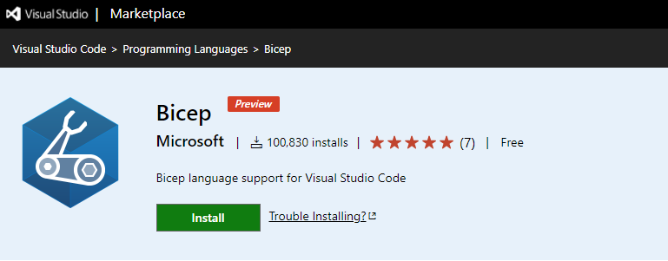
Visual Studio Code
https://marketplace.visualstudio.com/items?itemName=ms-azuretools.vscode-bicep

Slide 30
Simple Example
resource stg 'Microsoft.Storage/storageAccounts@2019-06-01' = {
name: 'uniquestorage001' // must be globally unique
location: 'eastus'
kind: 'Storage'
sku: {
name: 'Standard_LRS'
}
}

Slide 31
Parameters
param location string = 'eastus'
param storageAccountName string = 'uniquestorage001‘
resource stg 'Microsoft.Storage/storageAccounts@2019-06-01' = {
name: storageAccountName
location: location
kind: 'Storage'
sku: {
name: 'Standard_LRS'
}
}

Slide 32
Standard Sample
@minLength(3)
@maxLength(24)
param storageAccountName string = 'uniquestorage001‘
param location string = 'eastus' var storageSku = 'Standard_LRS' // declare variable and assign value
resource stg 'Microsoft.Storage/storageAccounts@2019-06-01' = {
name: storageAccountName
location: location
kind: 'Storage'
sku: {
name: storageSku // reference variable
}
}
output storageId string = stg.id // output resourceId of storage account

Slide 33
Data Types

Slide 34
Overview
array
bool
int
object
secureObject - indicated by modifier in Bicep
secureString - indicated by modifier in Bicep
string
https://docs.microsoft.com/en-us/azure/azure-resource-manager/bicep/data-types

Slide 35
Simple Types
param exampleBool bool = true
param exampleInt int = 1
param exampleString string = 'test value’
var storageName = 'storage${uniqueString(resourceGroup().id)}

Slide 36
Arrays
var index = 1
var exampleArray = [
1
2
3
]
param environment string = 'prod'
var environmentSettings = {
dev: {
name: 'dev'
}
prod: {
name: 'prod'
}
}
Arrays can have multiple types (f.e. string, object, int) inside

Slide 37
Objects
param exampleObject object = {
name: 'test name'
id: '123-abc'
isCurrent: true
tier: 1
}
var x = {
y: {
z: 'Hello`
a: true
}
q: 42
}

Slide 38
Secure Types
@secure()
param password string
@secure()
param configValues object

Slide 39
Any Type
resource wpAci 'microsoft.containerInstance/containerGroups@2019-12-01' = {
name: 'wordpress-containerinstance'
location: location
properties: {
containers: [
{
name: 'wordpress'
properties: {
...
resources: {
requests: {
cpu: '0.5'
memoryInGB: '0.7'
}
}
}
}
]
}
}
resource wpAci 'microsoft.containerInstance/containerGroups@2019-12-01' = {
name: 'wordpress-containerinstance'
location: location
properties: {
containers: [
{
name: 'wordpress'
properties: {
...
resources: {
requests: {
cpu: any('0.5')
memoryInGB: any('0.7')
}
}
}
}
]
}
}

Slide 40
Modules

Slide 41
Dependencies
module spModule './app-service-plan.bicep' = {
name: 'appServicePlanDeploy'
params: {
appName: appName
}
}
module appServiceModule './app-service.bicep' = {
name: 'appServiceDeploy'
params: {
appName: appName
appServicePlanID: spModule.outputs.appServicePlanID
APPINSIGHTS_INSTRUMENTATIONKEY: appInsightsModule.outputs.APPINSIGHTS_INSTRUMENTATIONKEY
}
}
Modules resolved based on external Files
Automatic order based on dependencies

Slide 42
param storagePrefix string
param storageSKU string = 'Standard_LRS'
param location string
resource stg 'Microsoft.Storage/storageAccounts@2019-04-01' = {
name: 'name'
location: location
sku: {
name: storageSKU
}
kind: 'StorageV2‘
}
output storageEndpoint object = stg.properties.primaryEndpoints
@minLength(3)
@maxLength(11)
param namePrefix string
param location string = resourceGroup().location
module stgModule './storageAccount.bicep' = {
name: 'storageDeploy'
params: {
storagePrefix: namePrefix
location: location
}
}
output storageEndpoint object = stgModule.outputs.storageEndpoint
storageAccount.bicep
mainTemplate.bicep

Slide 43
Scopes

Slide 44
Global Functions
tenant()
managementGroup()
managementGroup(name: string)
subscription()
subscription(subscriptionId: string)
resourceGroup()
resourceGroup(resourceGroupName: string)
resourceGroup(subscriptionId: string, resourceGroupName: string)

Slide 45
Scope Sample
module myModule './path/to/module.bicep' = {
name: 'myModule'
// deploy this module at the subscription scope
scope: subscription()
}
module myModule './path/to/module.bicep' = {
name: 'myModule'
// deploy this module into a different resource group
scope: resourceGroup(otherSubscription, otherResourceGroupName)
}

Slide 46
Resource Scope
// deploy a parent storage account resource
resource storageAcc 'Microsoft.Storage/storageAccounts@2019-06-01' = {
name: accountName
kind: 'StorageV2'
sku: {
name: 'Standard_LRS'
}
location: resourceGroup().location
}
// declare a lock resource extending the storage account by supplying the 'scope' property
resource lockResource 'Microsoft.Authorization/locks@2016-09-01' = {
name: 'DontDelete'
scope: storageAcc
properties: {
level: 'CanNotDelete'
}
}

Slide 47
Functions

Slide 48
Array functions
array
concat
contains
empty
first
intersection
last
length
min
max
range
skip
take
union

Slide 49
Resource functions
extensionResourceId
listAccountSas
listKeys
listSecrets
list*
pickZones
reference
resourceId - can be used at any scope, but the valid parameters change depending on the scope.
subscriptionResourceId
tenantResourceId
Many more...

Slide 50
Operators

Slide 51
Comparison
Operator | Name | Description
>= | Greater than or equal | Evaluates if the first value is greater than or equal to the second value.
> | Greater than | Evaluates if the first value is greater than the second value.
<= | Less than or equal | Evaluates if the first value is less than or equal to the second value.
< | Less than | Evaluates if the first value is less than the second value.
== | Equals | Evaluates if two values are equal.
!= | Not equal | Evaluates if two values are not equal.
=~ | Equal case-insensitive | Ignores case to determine if two values are equal.
!~ | Not equal case-insensitive | Ignores case to determine if two values are not equal.
https://docs.microsoft.com/en-us/azure/azure-resource-manager/bicep/operators-comparison

Slide 52
Logical
Operator | Name | Description
&& | And | Returns true if all values are true.
|| | Or | Returns true if either value is true.
! | Not | Negates a boolean value.
?? | Coalesce | Returns the first non-null value.
? : | Conditional expression | Evaluates a condition for true or false and returns a value.
https://docs.microsoft.com/en-us/azure/azure-resource-manager/bicep/operators-logical

Slide 53
Numeric
Operator | Name
* | Multiply
/ | Divide
% | Modulo
+ | Add
- | Subtract
- | Minus
https://docs.microsoft.com/en-us/azure/azure-resource-manager/bicep/operators-numeric
Notes:
Subtract and minus use the same operator. The functionality is different because subtract uses two operands and minus uses one operand.

Slide 54
existing keyword
resource stg 'Microsoft.Storage/storageAccounts@2019-06-01' existing = {
name: 'myacc'
scope: resourceGroup(mySub, myRg)
}
Resource will not be created,
but provides access to properties
https://github.com/Azure/bicep/blob/main/docs/spec/resources.md#referencing-existing-resources
Notes:
This is equivalent to using the ARM Template reference() function.

Slide 55
Loops
@batchSize(2)
resource storageAccountResources 'Microsoft.Storage/storageAccounts@2019-06-01' = [for i in range(0,3): {
name: 'storageName${i}'
location: resourceGroup().location
properties: {
supportsHttpsTrafficOnly: true
accessTier: 'Hot'
encryption: {
keySource: 'Microsoft.Storage'
services: {
blob: {
enabled: true
}
file: {
enabled: true
}
}
}
}
kind: 'StorageV2'
sku: {
name: 'Standard_LRS'
}
}]
resource parentResources 'Microsoft.Example/examples@2020-06-06‘ =
[for parent in parents: if(parent.enabled) {
name: parent.name
properties: {
children: [for child in parent.children: {
name: child.name
setting: child.settingValue
}]
}
}]
https://github.com/Azure/bicep/blob/main/docs/spec/loops.md
Notes:
Loops may be used to iterate over an array to declare multiple resources/modules or to set an array property inside a resource/module declaration. Loops may also be used when defining variables. Iteration over the array occurs over the elements of the array. The index of the iteration is also available.
@batchSize(2)

Slide 56
Deployment
az bicep group create -f ./main.bicep -g my-rg
Both Az CLI (2.20.0+) and the PowerShell Az module (v5.6.0+) have Bicep support built-in.

Slide 57
FAQ

Slide 58
Bicep Registry
To share modules within your organization, you can create a private module registry. You publish modules to that registry and give read access to users who need to deploy the modules. After the modules are shared in the registries, you can reference them from your Bicep files.
az bicep publish --file storage.bicep --target br:exampleregistry.azurecr.io/bicep/modules/storage:v1

Slide 59
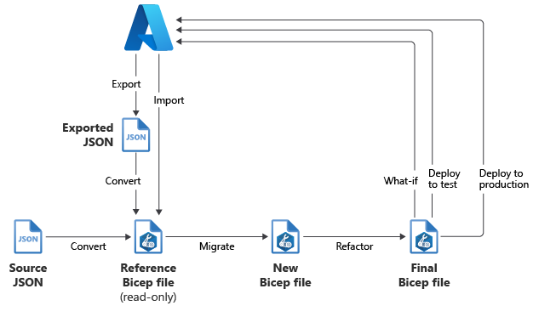
Migrate to Bicep

Slide 60
Bicep vs. other Tools
Different users prefer different configuration languages and tools. We want to make sure all of these tools provide a great experience on Azure. Bicep is part of that effort.
If you're happy using Terraform, there's no reason to switch. Microsoft is committed to making sure Terraform on Azure is the best it can be.
For customers who have selected ARM templates, we believe Bicep improves the authoring experience. Bicep also helps with the transition for customers who haven't adopted infrastructure as code.

Slide 61
Support (Production use)
Yes. Starting with v0.3, Bicep is supported by Microsoft support plans. Bicep has parity with what can be accomplished with ARM Templates. There are no breaking changes that are currently planned, but it's possible we'll need to create breaking changes in the future.

Slide 62
Biceps for Azure
Currently, we aren't planning for Bicep to extend beyond Azure. We want to fully support Azure and optimize the deployment experience.
Meeting that goal requires working with some APIs that are outside of Azure. We expect to provide extensibility points for those scenarios.

Slide 63
What happens with ARM Templates?
They continue to function exactly as they always have. You don't need to make any changes. We'll continue to support the underlying ARM template JSON language. Bicep files compile to JSON, and that JSON is sent to Azure for deployment.
When you're ready, you can decompile the JSON files to Bicep.

Slide 64
Resources
Watch the project: https://github.com/azure/bicep
Microsoft Learn Learning Path
Introduction to infrastructure as code using Bicep
Deploy Azure resources by using Bicep templates
Build reusable Bicep templates by using parameters
Build flexible Bicep templates by using conditions and loops
Deploy child and extension resources by using Bicep
Extend templates by using deployment scripts

